Slide 1
Chapter 24
Two-Way Tables and the
Chi-Square Test
Lecture Slides

Slide 2

Case Study: Two-Way Tables and the Chi-Square Test* 1
Purdue is a Big Ten university that emphasizes engineering, scientific, and technical fields.
In the 2013–2014 academic year, Purdue had 1670 professors of all ranks (assistant, associate, and full), of whom 483 were women. That’s just under 29%, or slightly less than 3 out of every 10 professors.

Slide 3
Case Study: Two-Way Tables and the Chi-Square Test* 2
These numbers don’t tell us much about the fields of expertise of women on the faculty.
We need to look at relationships among several variables, not just at sex alone.
Female faculty members are more common in the humanities than in engineering.
We can also look at the relationship between sex and a variable particularly important to faculty members, academic rank.

Slide 4
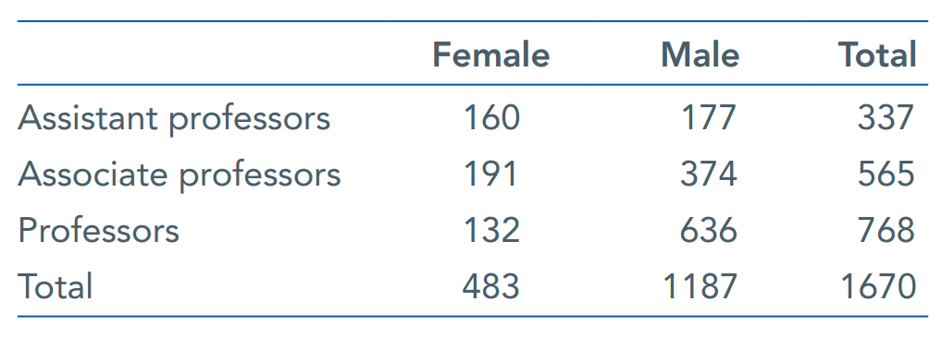
Case Study: Two-Way Tables and the Chi-Square Test* 3
Universities tend to be run by full professors.
Here is a two-way table that categorizes Purdue’s 1670 faculty members by both sex and academic rank (professors typically start at the rank of assistant, then associate, then full professor):

Slide 5
Case Study: Two-Way Tables and the Chi-Square Test* 4
What does this table tell us about the rank of women on the faculty?
In this chapter, we will learn how to interpret such tables. By the end of the chapter, you will be able to interpret this table.

Slide 6
Two-Way Tables 1
One measurement of student success is the percent completing a bachelor’s degree within 6 years.
The following two-way table is representative of the percents of students completing a bachelor’s degree within 6 years by race/ethnicity:
Race/ ethnicity | White | Black | Hispanic | Asian | American Indian/ Alaska Native | Two or more races | Total
Graduated | 6963 | 1063 | 1388 | 792 | 69 | 175 | 10,450
Did not graduate | 3933 | 1614 | 1163 | 295 | 110 | 119 | 7234
Total | 10,896 | 2667 | 2551 | 1087 | 179 | 294 | 17,684

Slide 7
Two-Way Tables 2
Graduation status (completing a bachelor’s degree within 6 years or not) and race of students are both categorical variables.
Use a two-way table to display the relationship between two categorical variables.
Race/ ethnicity | White | Black | Hispanic | Asian | American Indian/ Alaska Native | Two or more races | Total
Graduated | 6963 | 1063 | 1388 | 792 | 69 | 175 | 10,450
Did not graduate | 3933 | 1614 | 1163 | 295 | 110 | 119 | 7234
Total | 10,896 | 2667 | 2551 | 1087 | 179 | 294 | 17,684

Slide 8
Two-Way Tables 3
Graduation status is the row variable because each row in the table describes one of the possible admission decisions for a student.
Race is the column variable because each column describes one of the racial/ethnic groups.
Race/ ethnicity | White | Black | Hispanic | Asian | American Indian/ Alaska Native | Two or more races | Total
Graduated | 6963 | 1063 | 1388 | 792 | 69 | 175 | 10,450
Did not graduate | 3933 | 1614 | 1163 | 295 | 110 | 119 | 7234
Total | 10,896 | 2667 | 2551 | 1087 | 179 | 294 | 17,684

Slide 9
Two-Way Tables 4
Race/ ethnicity | White | Black | Hispanic | Asian | American Indian/ Alaska Native | Two or more races | Total
Graduated | 6963 | 1063 | 1388 | 792 | 69 | 175 | 10,450
Did not graduate | 3933 | 1614 | 1163 | 295 | 110 | 119 | 7234
Total | 10,896 | 2667 | 2551 | 1087 | 179 | 294 | 17,684
The “Total” column at the right of the table contains the totals for graduation status for all students (for all racial/ethnic groups combined).
The “Total” row at the bottom of the table gives the distribution of race for students (with both categories of graduation status combined).

Slide 10
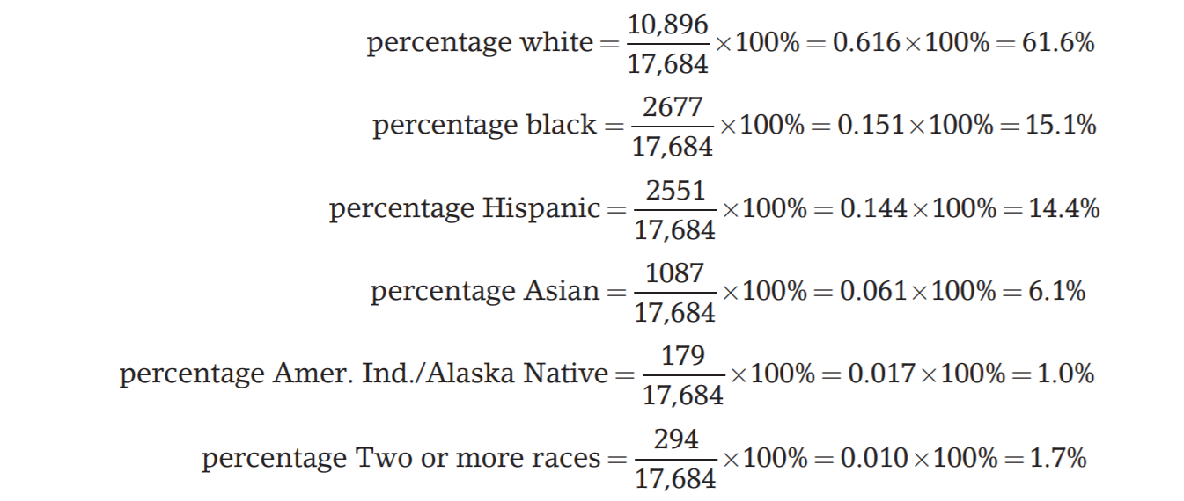
Two-Way Tables 5
It is often clearer to present these distributions
using percentages. We might report the distribution
of race as:

Slide 11
Two-Way Tables 6
The nature of the relationship between graduation status and race cannot be deduced from the separate distributions but requires the full table.
To describe relationships among categorical variables, calculate appropriate percents from the counts given.

Slide 12
Two-Way Tables 7
Race/ ethnicity | White | Black | Hispanic | Asian | American Indian/ Alaska Native | Two or more races | Total
Graduated | 6963 | 1063 | 1388 | 792 | 69 | 175 | 10,450
Did not graduate | 3933 | 1614 | 1163 | 295 | 110 | 119 | 7234
Total | 10,896 | 2667 | 2551 | 1087 | 179 | 294 | 17,684
Because there are only two categories of graduation status, we can see the relationship between race and graduation status by comparing the percents of those who completed a bachelor’s degree within 6 years for each race:

Slide 13
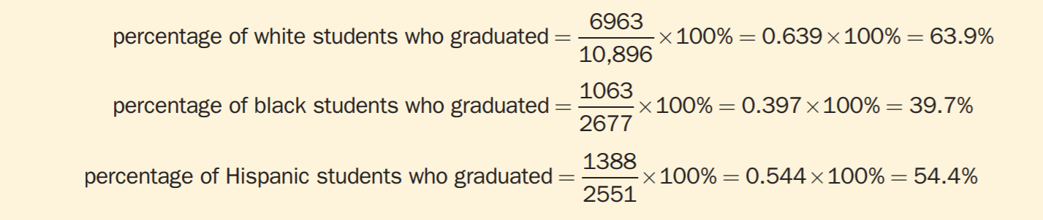
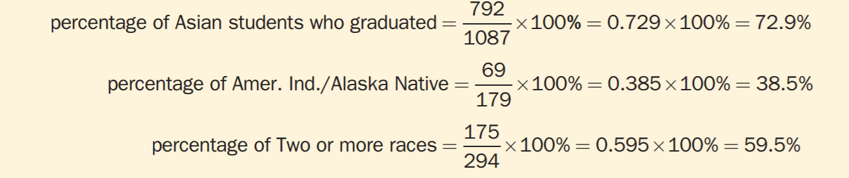
Two-Way Tables 8
Over 60% of the white students and more than 70% of the Asian students completed a bachelor’s degree within 6 years, but less than 40% of black students and American Indian/Alaska Native students completed a bachelor’s degree within 6 years.

Slide 14
Inference for a Two-Way Table 1
Imagine displaying data in a two-way table to see if two categorical variables are related to each other.
Look at sample data, turn them into percentages, and look for an association between the row and column variables.
Is the association in the sample evidence of an association between these variables in the entire population?
This is a question for a significance test.

Slide 15
Example: Treating Cocaine Addiction
Cocaine addicts need the drug to feel pleasure. Perhaps, giving them a medication that fights depression will help them resist cocaine.
A 3-year study compared an antidepressant called desipramine, lithium (a standard treatment for cocaine addiction), and a placebo.
The subjects were 72 chronic users of cocaine who wanted to break their drug habit. An equal number of the subjects were randomly assigned to each treatment.

Slide 16
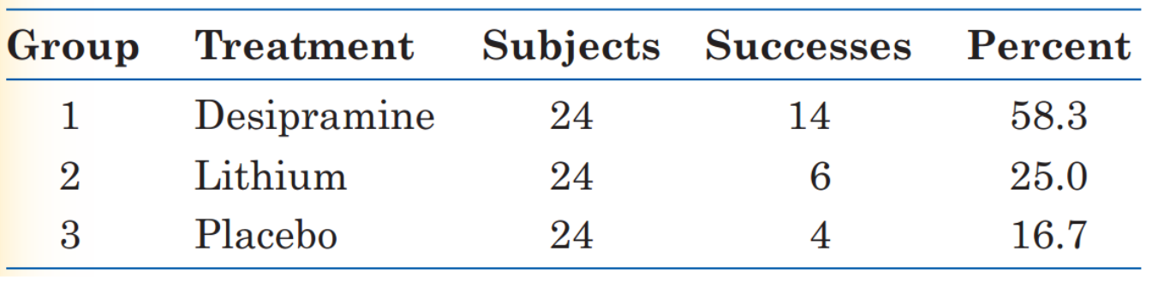
Example: Treating Cocaine Addiction (continued)
The sample proportions of subjects who did not use cocaine are quite different.
The percentage of subjects in the desipramine group who did not use cocaine was much higher than for the lithium or placebo group.

Slide 17
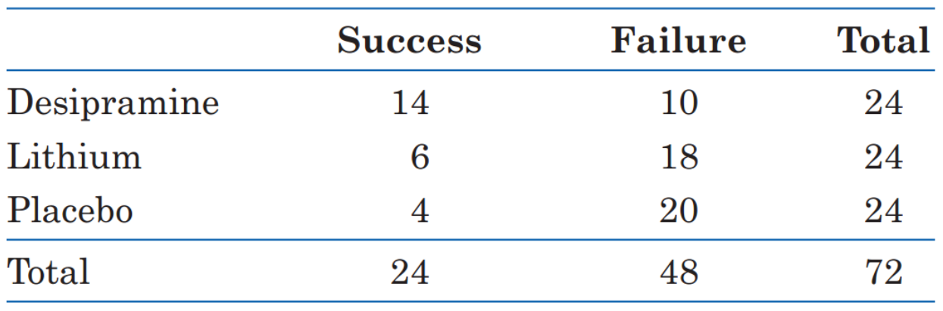
Inference for a Two-Way Table 2
The test that answers this question starts with a two-way table.
Here’s the table for the data:

Slide 18
Inference for a Two-Way Table 3
Our null hypothesis, as usual, says that the treatments have no effect.
That is, addicts do equally well on any of the three treatments. The differences in the sample are just the result of chance. Our null hypothesis is:
H₀: There is no association between the treatment an addict receives and whether or not there is success in not using cocaine in the population of all cocaine addicts.

Slide 19
Inference for a Two-Way Table 4
The alternative hypothesis says, “Yes, there is some association between the treatment an addict receives and whether or not he succeeds in staying off cocaine.”
H_{a}: There is an association between the treatment an addict receives and whether or not there is success in not using cocaine in the population of all cocaine addicts.

Slide 20
Inference for a Two-Way Table 5
To test H₀, we compare the observed counts in a two-way table with the expected counts.
The expected counts are what we would expect—except for random variation—if H₀ were true.
If the observed counts are far from the expected counts, that is evidence against H₀.

Slide 21
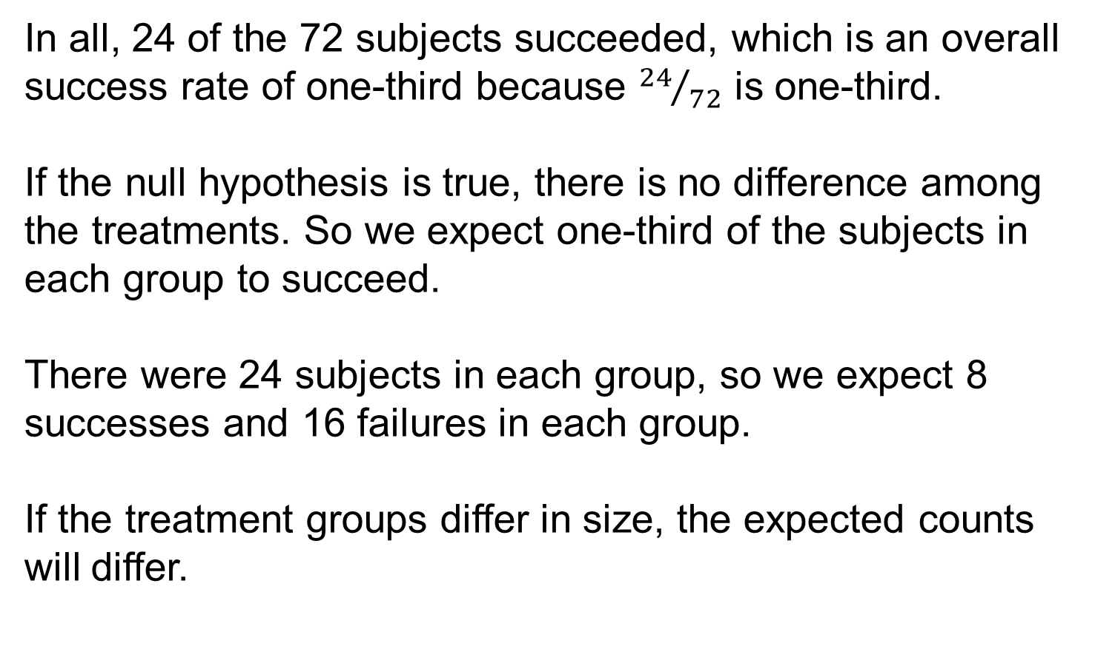
Inference for a Two-Way Table 6
In all, 24 of the 72 subjects succeeded, which is an overall success rate of one-third because ${24}/{72}$ is one-third.
If the null hypothesis is true, there is no difference among the treatments. So we expect one-third of the subjects in each group to succeed.
There were 24 subjects in each group, so we expect 8 successes and 16 failures in each group.
If the treatment groups differ in size, the expected counts will differ.

Slide 22
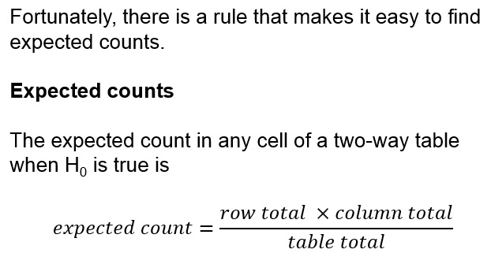
Inference for a Two-Way Table 7

Slide 23
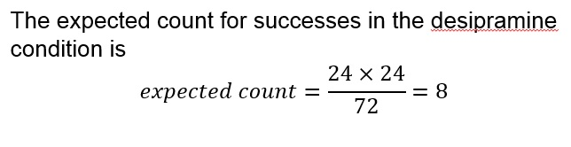
Inference for a Two-Way Table 8

Slide 24
The Chi-Square Test 1
To see if the data give evidence against the null hypothesis of “no relationship,’’ compare the counts in the two-way table with the counts we would expect if there really were no relationship.
If the observed counts are far from the expected counts, that’s the evidence we were seeking.
The significance test uses a statistic that measures how far apart the observed and expected counts are.

Slide 25
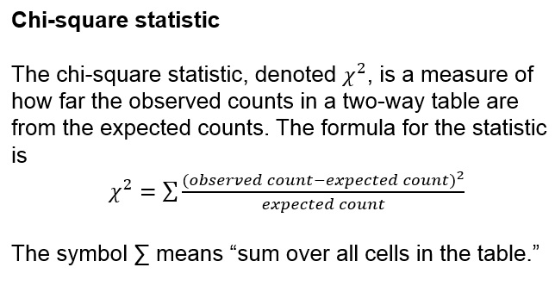
The Chi-Square Test 2

Slide 26
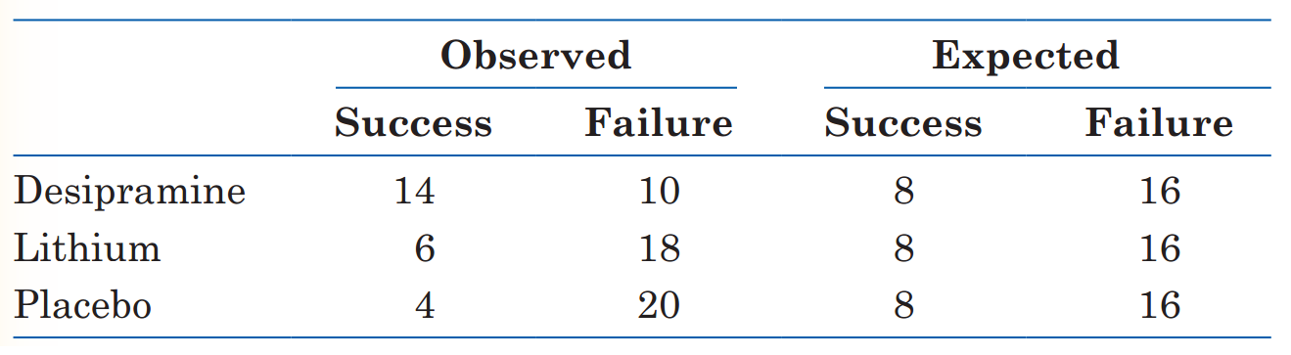
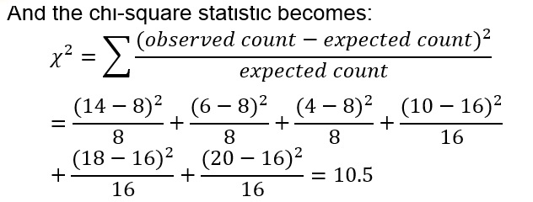
The Chi-Square Test 3

Slide 27
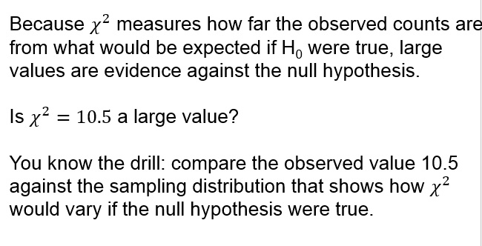
The Chi-Square Test 4

Slide 28
The Chi-Square Test 5
This is not a normal distribution.
It is a right-skewed distribution, whose values cannot be negative.
This sampling distribution is different for two-way
tables of different sizes.

Slide 29
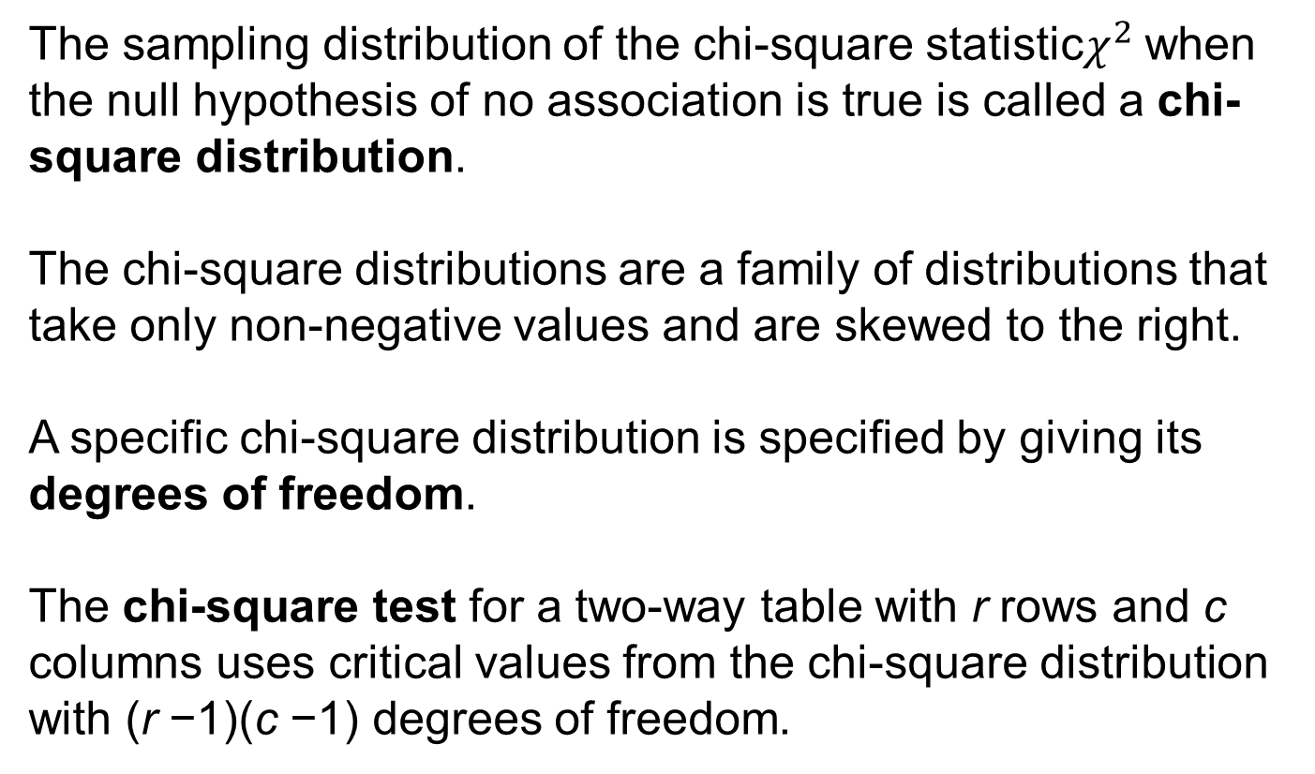
The Chi-Square Test 6
The sampling distribution of the chi-square statistic$χ^{2}$ when the null hypothesis of no association is true is called a chi-square distribution.
The chi-square distributions are a family of distributions that take only non-negative values and are skewed to the right.
A specific chi-square distribution is specified by giving its degrees of freedom.
The chi-square test for a two-way table with r rows and c columns uses critical values from the chi-square distribution with (r −1)(c −1) degrees of freedom.

Slide 30
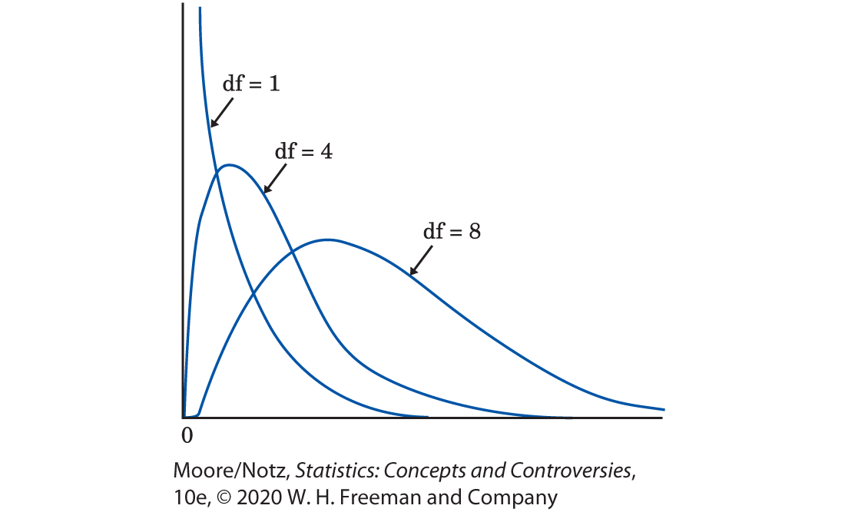
The Chi-Square Test 7

Slide 31
The Chi-Square Test 8
We let software get the areas under the chi-square curve to calculate P-values for us. Table 24.1 is a shortcut.
It shows how large the chi-square statistic must be in order to be significant at various levels. Each number of degrees of freedom has a separate row in the table. We see, for example, that a chi-square statistic with 3 degrees of freedom is significant at the 5% level if it is greater than 7.81 and is significant at the 1% level if it is greater than 11.34.

Slide 32
The Chi-Square Test 9
We let software get the areas under the chi-square curve to calculate P-values for us. Table 24.1 is a shortcut.
It shows how large the chi-square statistic must be in order to be significant at various levels.
This isn’t as good as an actual P-value, but it is often good enough.

Slide 33
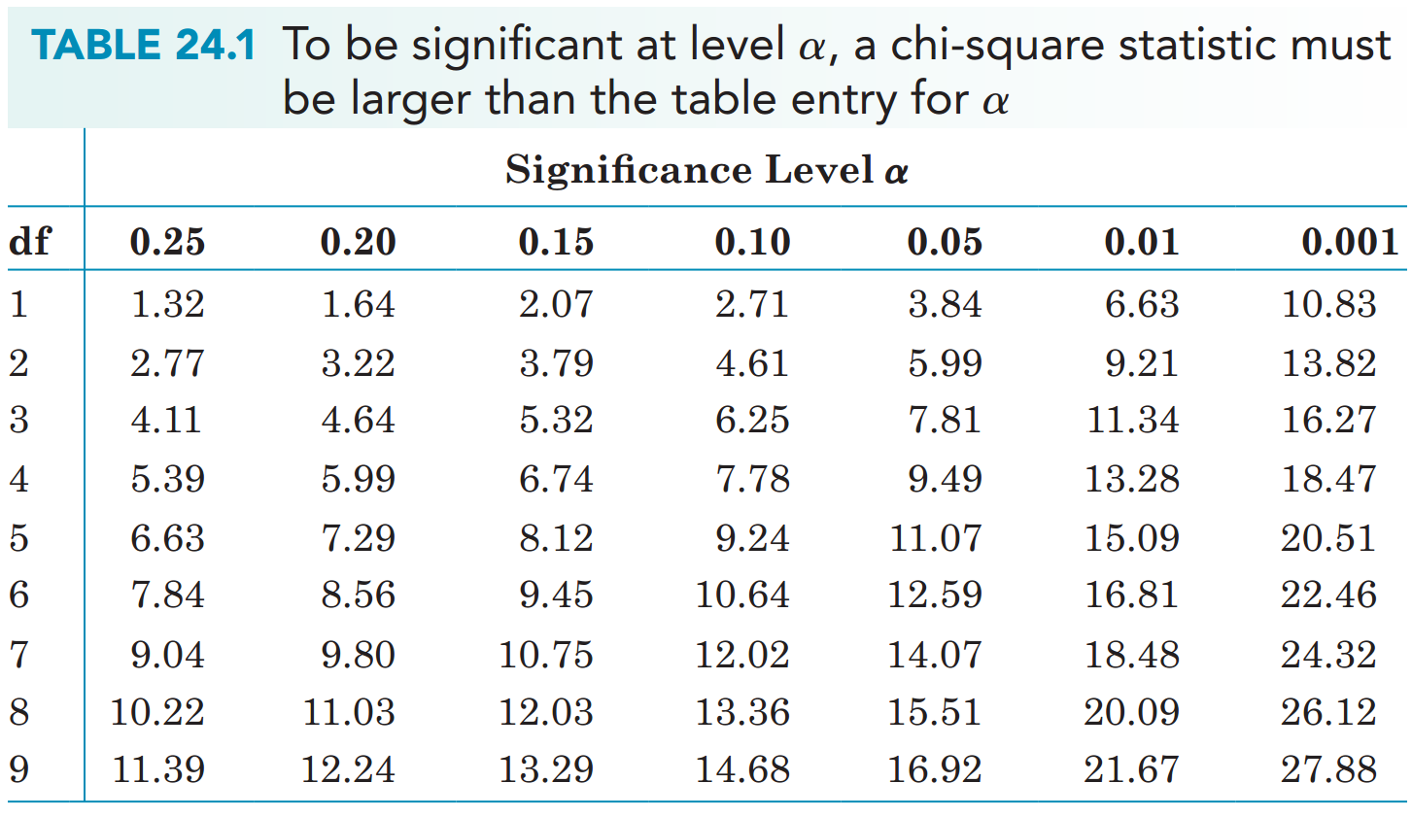
The Chi-Square Test 10

Slide 34
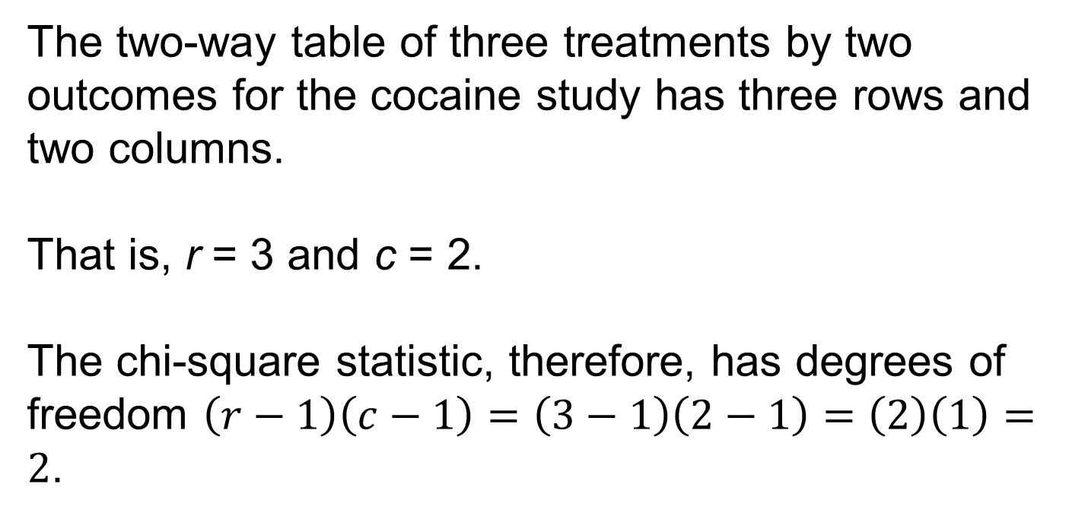
The Chi-Square Test 11
The two-way table of three treatments by two outcomes for the cocaine study has three rows and two columns.
That is, r = 3 and c = 2.
The chi-square statistic, therefore, has degrees of freedom $\left(r−1\right)\left(c−1\right)=\left(3−1\right)\left(2−1\right)=\left(2\right)\left(1\right)=2$.

Slide 35
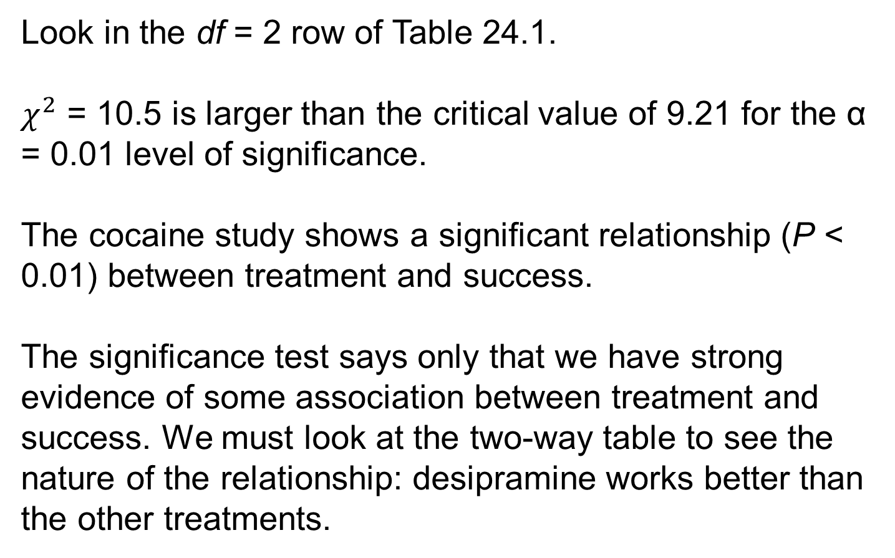
The Chi-Square Test 12
Look in the df = 2 row of Table 24.1.
$χ^{2}$ = 10.5 is larger than the critical value of 9.21 for the α = 0.01 level of significance.
The cocaine study shows a significant relationship (P < 0.01) between treatment and success.
The significance test says only that we have strong evidence of some association between treatment and success. We must look at the two-way table to see the nature of the relationship: desipramine works better than the other treatments.

Slide 36
Using the Chi-Square Test 1
As does our test for a population proportion, the chi-square test uses some approximations that become more accurate as we take more observations.
You can safely use the chi-square test when no more than 20% of the expected counts are less than 5 and all individual expected counts are 1 or greater.
The cocaine study easily passes this test: All the expected cell counts are either 8 or 16.

Slide 37
Simpson’s Paradox
As is the case with quantitative variables, the effects of lurking variables can change or even reverse relationships between two categorical variables.
In the following example, we will find that, sometimes, a lurking variable might reverse the relationship of what we would expect to find in the data.

Slide 38
Example: Do Medical Helicopters Save Lives? 1
Accident victims are sometimes taken by helicopter from the accident scene to a hospital.
Helicopters save time. Do they also save lives?
Let’s compare the percent of accident victims who die with helicopter evacuation and the percent with the usual transport to a hospital by road.
The numbers here are hypothetical, but they illustrate a phenomenon that often appears in real data.

Slide 39
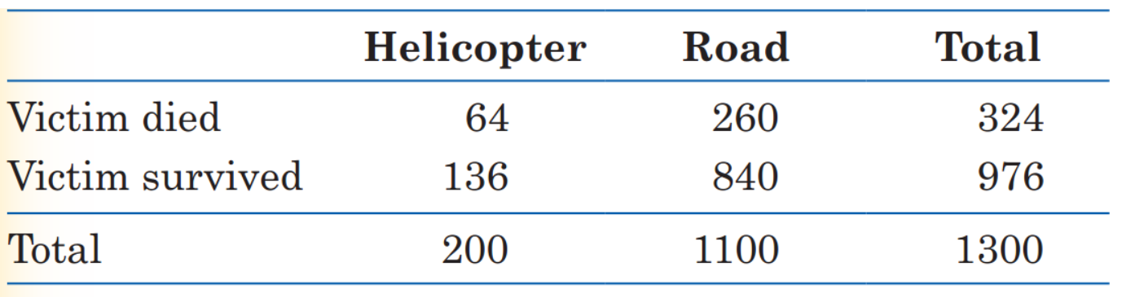
Example: Do Medical Helicopters Save Lives? 2
We see that 32% (64 out of 200) of helicopter patients died, but only 24% (260 out of 1100) of the others died.
That seems discouraging.

Slide 40
Example: Do Medical Helicopters Save Lives? 3
The explanation is that the helicopter is sent mostly to serious accidents, so the victims transported by helicopter are more often seriously injured.
They are more likely to die with or without helicopter evacuation.
We will break the data down into a three-way table that classifies the data by the seriousness of the accident.
We will present a three-way table as two or more two-way tables side-by-side, one for each value of the third variable.

Slide 41
Example: Do Medical Helicopters Save Lives? 4
How can it happen that the helicopter does better for both groups of victims but worse when all victims are combined? Look at the data: half the helicopter transport patients are from serious accidents, compared with only 100 of the 1100 road transport patients. So the helicopter carries patients who are more likely to die. The original two-way table did not take into account the seriousness of the accident and was therefore misleading. This is an example of Simpson’s paradox.

Slide 42
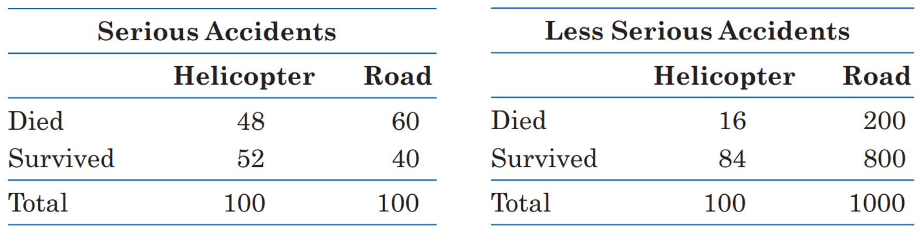
Example: Do Medical Helicopters Save Lives? 5
How can it happen that the helicopter does better for both groups of victims but worse when all victims are combined?
Look at the data: Half the helicopter transport patients are from serious accidents, compared with only 100 of the 1100 road transport patients.

Slide 43
Example: Do Medical Helicopters Save Lives? 6
So the helicopter carries patients who are more likely to die.
The original two-way table did not take into account the seriousness of the accident and was therefore misleading.
This is an example of Simpson’s paradox.

Slide 44
Example: Do Medical Helicopters Save Lives? 7
Simpson’s Paradox
An association or comparison that holds for all of several groups can disappear or even reverse direction when the data are combined to form a single group. This situation is called Simpson’s paradox.
Simpson’s paradox is just an extreme form of the fact that observed associations can be misleading when there are lurking variables. Remember the caution from Chapter 15: beware the lurking variable.

Slide 45
Statistics in Summary 1
● Categorical variables group individuals into classes. To display the relationship between two categorical variables, make a two-way table of counts for the classes. We describe the nature of an association between categorical variables by comparing selected percentages.
● As always, lurking variables can make an observed association misleading. In some cases, an association that holds for every level of a lurking variable disappears or changes direction when we lump all levels together. This is Simpson’s paradox.

Slide 46
Statistics in Summary 2
● The chi-square test tells us whether an observed association in a two-way table is statistically significant. The chi-square statistic compares the counts in the table with the counts we would expect if there were no association between the row and column variables. The sampling distribution is not Normal. It is a new distribution, the chi-square distribution.

